Slide 1
Caregivers in Idaho
Idaho Caregiver Alliance
Sarah Toevs
Pam Catt-Oliason
Marilyn Sword

Slide 2
Mission and Vision
advance the well-being of caregivers across the lifespan by promoting collaboration that improves access to quality, responsive support across the state
a statewide voice, convener, and catalyst for sustaining and supporting these essential providers of care

Slide 3
Idaho Caregiver Alliance
more than 50 public and private organizations and 250 individual members
launched in 2013 with support from the Administration for Community Living
led by the Idaho Commission on Aging in collaboration with the Center for the Study of Aging at Boise State University

Slide 4
More than 1 in 4 Idahoans are caregivers
make it possible for children and adults living with disabilities, long term illnesses and frailty to live in their home and community
provide estimated $2 billion/year in unpaid care
most juggle paid work and caregiving responsibilities

Slide 5
Idaho Caregivers
Save Idaho resources by delaying need for institutional care
  Medicaid is the primary payer for institutional care in Idaho
    $2.4 billion expenditure in 2012
  Over 50% of Medicaid budget spent on institutional care
Medicaid Expenditures for Long-Term Services and Supports in FFY 2012, CMS, April 28, 2014. http://www.medicaid.gov/medicaid-chip-program-information/by-topics/long-term-services-and-supports/downloads/ltss-expenditures-2012.pdf
Notes:
Nursing homes; ICF/IID - intermediate care facilities for people with individual intellectual disabilities; Mental Health facilities including DSH - disproportionate share hospital payments

Slide 6
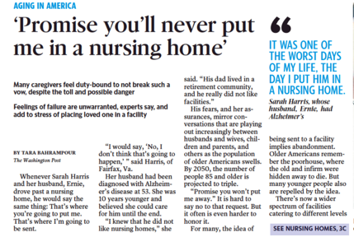
A Caregiver’s Fear

Slide 7
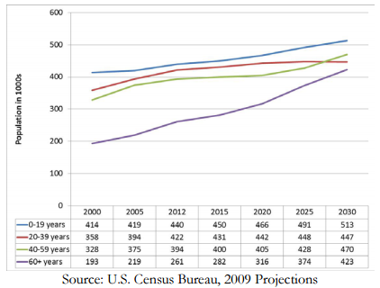
60 + age group fastest growing in Idaho

Slide 8
House Concurrent Resolution 24
create a caregiver taskforce
examine policies, resources and programs available for caregivers in Idaho and other states
study innovative ways to support unpaid family caregivers

Slide 9
Caregiver Taskforce: Membership
AARP Idaho
Ada County Community Paramedics
Advocates for Families/Caregivers
Area Agency on Aging - CSI
Blue Cross of Idaho
Caregivers
Caregiver Support Agencies
Center for the Study of Aging - BSU
Community Partnerships of Idaho
Disability Rights Idaho
Friends in Action
Home Care and Hospice Agencies
Idaho Alzheimer’s Planning Group
Idaho Area Health Education Center
Idaho Association of Counties
Idaho Commission on Aging
IDHW - Behavioral Health, Public Health, Medicaid
Idaho Health Care Association
Idaho Hospital Association
Idaho Parents Unlimited
Jannus
Living Independence Network
MS Society
Northwest A.D.A. Center of Idaho
Qualis Health
Regence Blue Shield
Senior Health Insurance Benefits Advisors (SHIBA)
St. Luke’s, Mountain States Tumor Institute
Treasure Valley YMCA
Veteran’s Administration

Slide 10
Taskforce Findings: gaps in resources
Assistance is limited, fragmented and based mostly on the care recipient.
Inadequate training and information for caregivers.
Caregiver support is lacking.
Caregiver stress has costs.
Non-profits have not been a sustainable resource.
Respite resources are inadequate.
Respite support is underfunded.
No options for pediatric respite care in Idaho.

Slide 11
Taskforce Recommendations
Supports For Family Caregivers
Equip and expand a network of individuals who assist family caregivers to understand, access, and arrange complex services.
Provide access to training for caregivers on fundamental care responsibilities and self-care strategies.
Community Awareness And Engagement
Increase public awareness about caregiving including helping people identify as caregivers.

Slide 12
Taskforce Recommendations
Integration of Family Caregivers into Health Systems Transformations
Influence health care providers to recognize family caregivers as member of the health care team.
Build community resources with the medical-health neighborhood to support family caregivers
Partner with SHIP Regional Health Collaboratives.
Integrate the needs and contributions of unpaid family caregivers in other system transformation efforts.

Slide 13
Going Forward
We ask that you:
Learn more about the issues facing unpaid family caregivers in Idaho.
Identify the caregivers in your life.
Partner with the Idaho Caregiver Alliance to identify resources for family caregivers.
Endorse the collaboration between the Idaho SHIP and the Caregiver Alliance.
Support development of a state plan to implement the recommendations identified in this report.
Become a caregiver champion!

